Slide 1

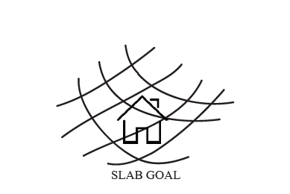
Look
the Sky
Down
[more light, more smile]
a new
opening
cover
GOAL SLAB

Slide 2

GOAL SLAB
Prototype sketch
What?
Coverage
Why?
The glass
Open your
House
Like a box
The light
The air
Integrated
Sliding system
Who?
How?

Slide 3
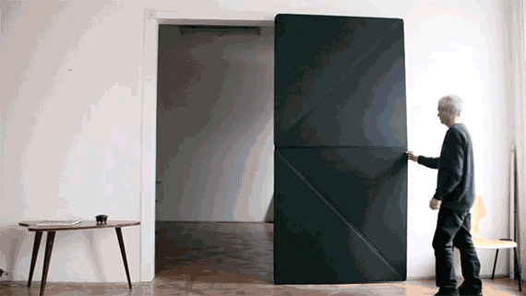
My ispiration
NEW SOLUTION DESIGN
"You just have to push it [to open the door from the other side] — that's all," (K. Torggler, Business Insider )
A new option like a different opening
Klemens
Torggler
and his mazing
kinetic doors .

Slide 4
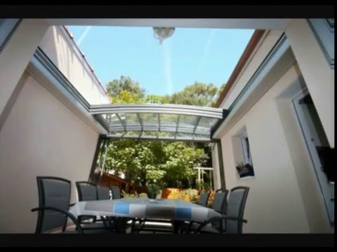
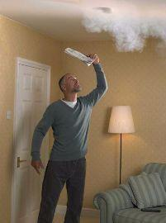
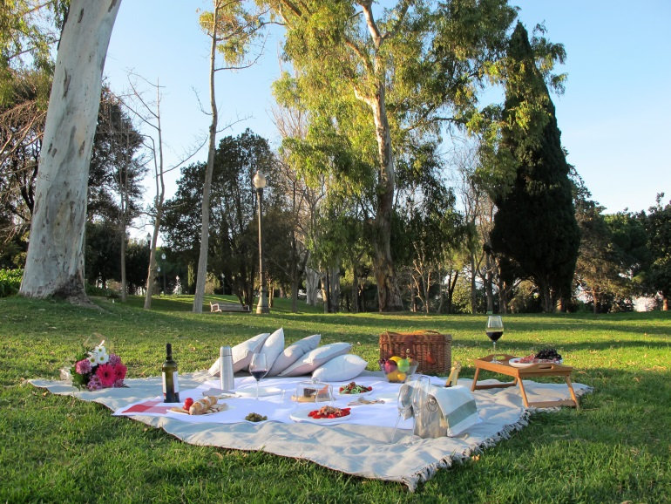
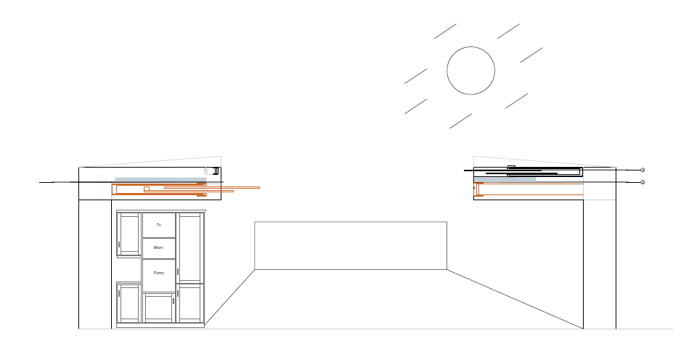



NEW
SOLUTION
DESIGN
WHY DON’T OPEN THE DOOR?
THE BENEFITS OF THE OPEN AIR IN YOUR COMFORT .
Daylighting ,and consequently
people’s efficiency, and
productivity
LIGHTING RESEARCH CENTER (LRC,New York)

Slide 5
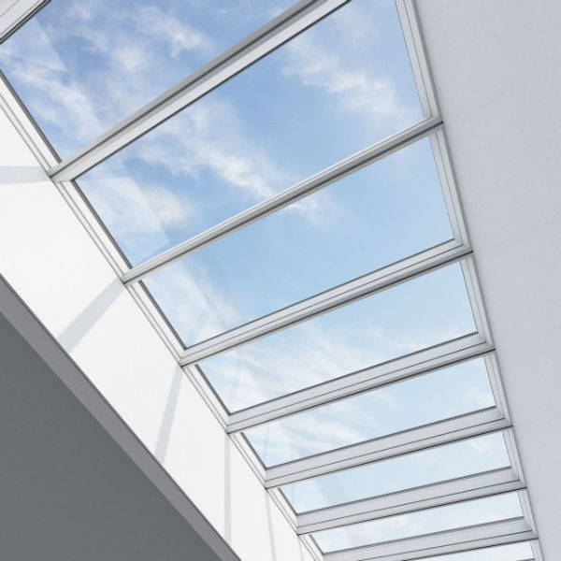
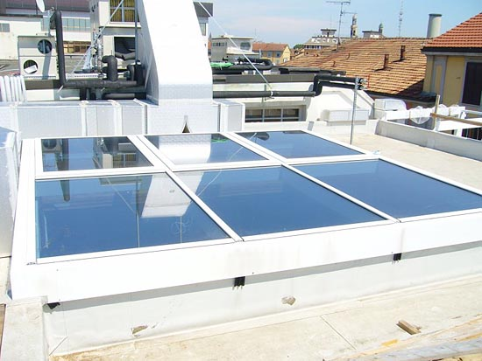
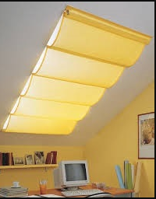
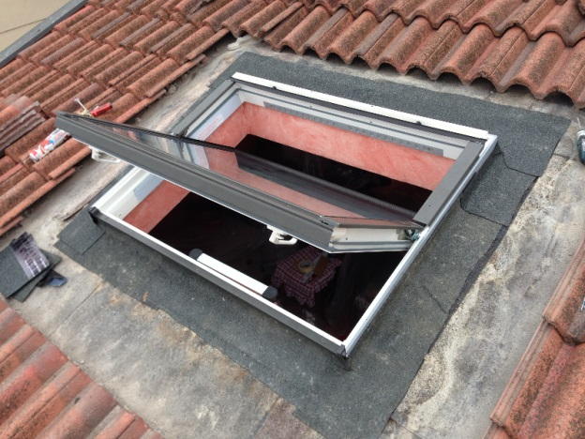
ABOUT ALTERNATIVES
The skylight
not provide Thermal
Benefits
is not an integrated roof
Is used for
non-residential attics
The locking system depends on the size
YOU CAN CHOOSE
A SKYLIGHT
Window Roto
.
Window Roto
It has an insulating material, better than a normal skylight
Covered space is limited

Slide 6
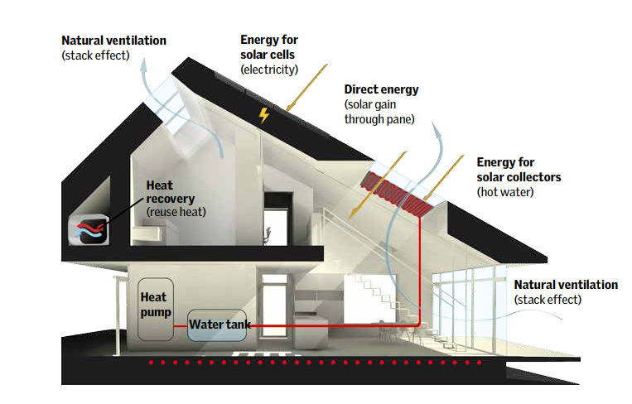
THIS ELEMENT IS USEFUL FOR DIRECT VENTILATION, MANY TIMES
DIRECT VENTILATION
cross
CROSS VENTILATION
AND HORIZONTAL
ARE MIXED

Slide 7
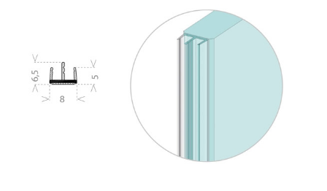
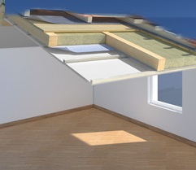
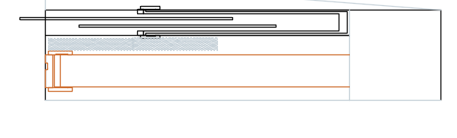
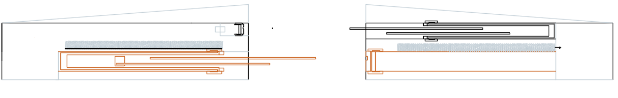
THE SOLUTION
YOU CAN CHOOSE THE GLASS WITH SOLAR CONTROL
YOU HAVE 3 OPTIONS:
-YOU CAN CHOOSE TO OPEN GLASS AND PANNEL TOGETHER
-YOU CAN CHOOSE ONLY THE GLASS
-YOU CAN CHOOSE ONLY THE PANNEL
WWW.ARTECNICA.COM

Slide 8
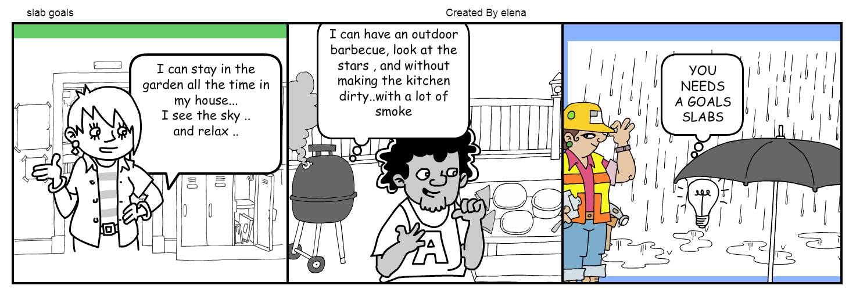
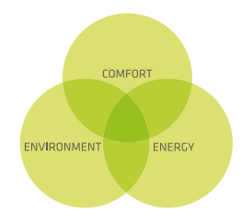
KEY ACTIVITIES: Renovation or new construction
KEY PARTENERS: construction company /private,
glass companies
KEYSUCCES FACTOR:
New roof/slab in the market
Target Market
BUILDINGS COMPANIES
PRIVATE PEOPLE
( for luxury house)
RESTAURANTS OWNER

Slide 9

How to put it on the market?
DIRECT
CONTACT
IN THE
STORE
NEWSLETTER
TO THE NEWSPAPERS OF DESIGN
STORE
CONSTRACTION
COMPANIES
VIDEO ON
YOUTUBE WITH
3DMODEL
PUBLIC
ANNOUNCEMENT
SOCIAL
MEDIA
what we need?
specialized technician
Company that builds a real prototype
and so make a advertising and sponsor
budget for application about the
Design Crack model in laboratoty
(verification of the glass panel about
structural verifications )

Slide 10
Elena bonapitacola
https://elenabonapitacola.wixsite.com/pippa

